Slide 1

BDM Capstone Project
Optimizing storage constraints and efficient employment of capital among different categories of products in a versatile shop
Abhijit Nandi [22f100155]
Indian Institute of Technology, Madras, Chennai
22f1001555@ds.study.iitm.ac.in

Slide 2
ABOUT THE BUSINESS
.
A retail multi segmented store established in 2000 by Mr. F.P Nandi in the Bolpur, West Bengal, India
Three segments, Ice Cream, Bakery and Varnish Products. While Ice Cream and Bakery end products are consumable and seasonal, some Varnish products are highly poisonous.
Ice Cream division a B2B business has seasonality component to it.

Slide 3




Problems: Ice Cream division
Managing inventory of large category of products thus facing frequent out of stocks or surplus inventory.
Frequent Price fluctuations due to import of raw material, supply chain disruption, international pricing, Government policies.
Fluctuating demand and seasonal component associated with the business.
Management of storage space between poisonous varnish segment products and consumable ice cream making products such that there is no possibility of any contamination.

Slide 4
Objectives : Optimize Storage Space & capital employment
Identification of products that the most important for the operation of the business.
Prioritization of the products based on parameters like demand trends, purchase price fluctuations, required space for storage etc.
Finding an efficient bulk storage mechanism to address the issues of stock outs and surplus stocks.
Predicting a safety stock cushion which can tackle certain demand and price fluctuations.
Identifying a safe mechanism to store all the products without the fear of contaminations.
Data Collection
The data that the business has provided consists of total available storage data, daily sales data for the duration (Jan-May), 2022 and purchase data for the duration of (Oct-May), 2021-22.

Slide 5
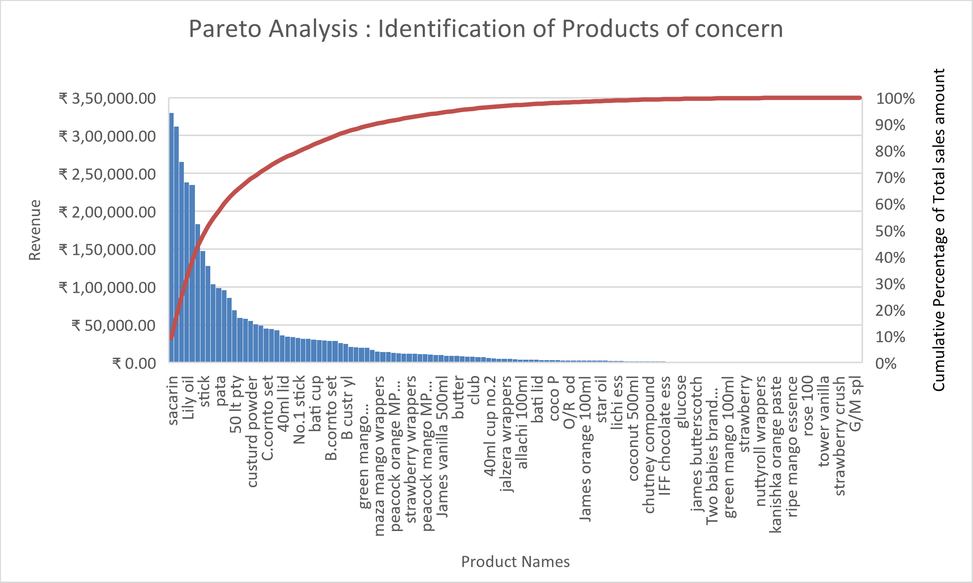
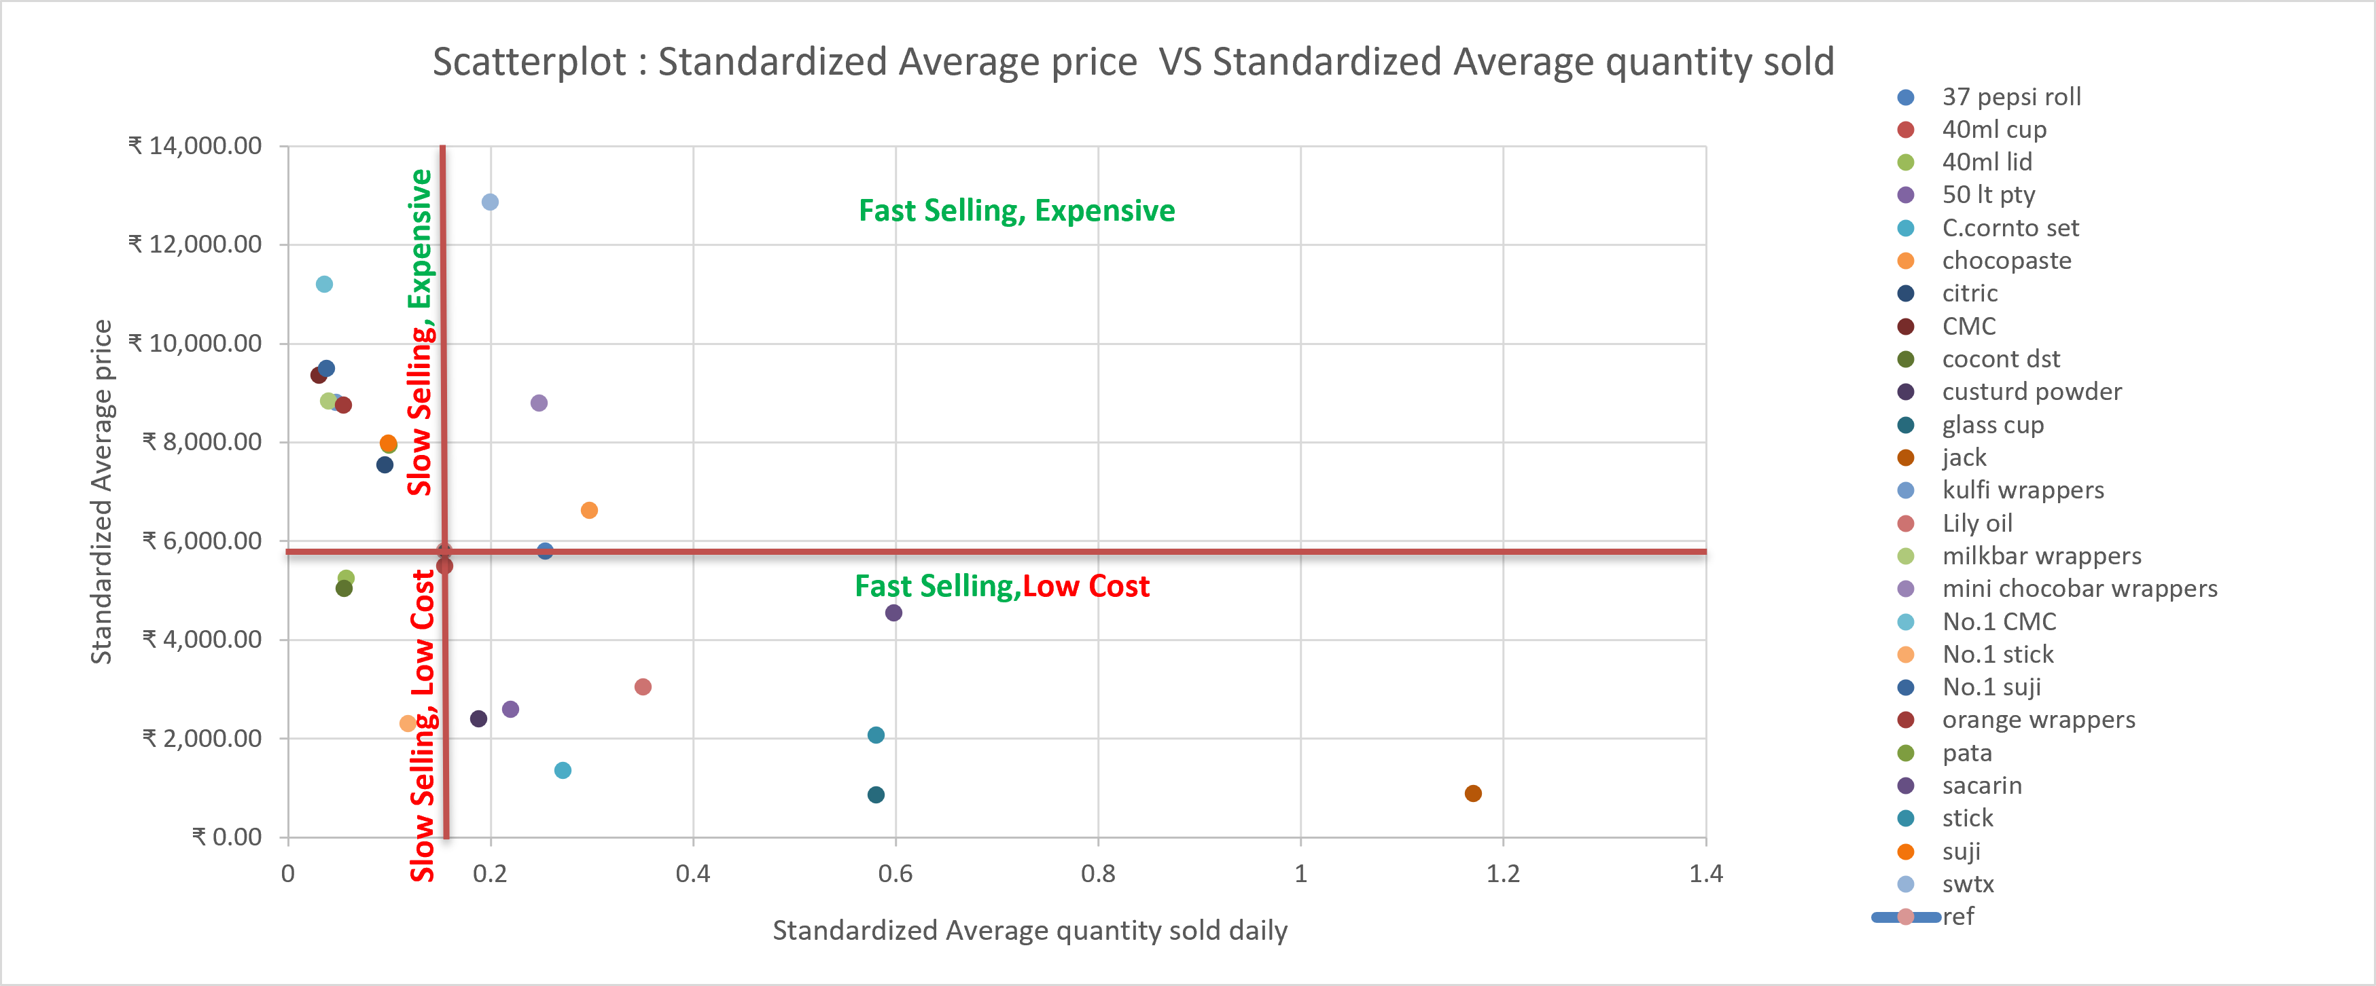
POCs : Identification & Product Categorization
Revenue Pareto analysis on the demand side reveals that out of 131 different products only 25 products are contributing 80% to the revenue. These are the most important products for stock keeping and called ‘Products of Concern’ (POC).
All the POCs are categorized into four categories based on the unit selling price and daily demand quantity.
Fast selling & Expensive products are given most priority in terms of bulk storage.
Slow selling and low cost products have the least priority.
The reference line is drawn on the median value of unit sell price and average daily demand
POCs

Slide 6
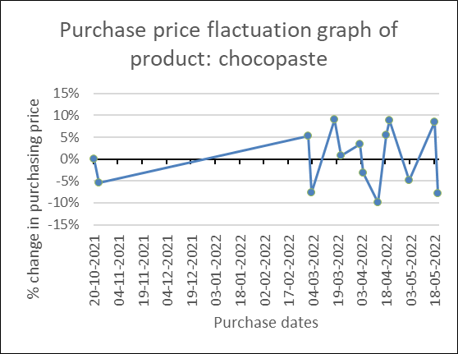
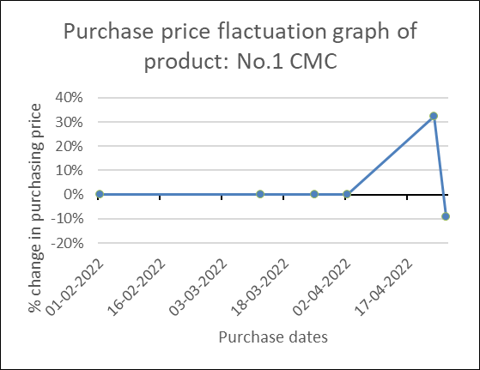


Demand Trends and Fluctuation in Purchase Prices
Augmented Dickey-Fuller (ADF) test to evaluate seasonality of demand
Purchase Price Fluctuation of POCs
ADF Test of stationarity: A statistical hypothesis test on time series data, which tests for the stationarity of the tested data.
Null hypothesis ($H_{0}$) : time series is Non-Stationary.
Reject Null hypothesis ($H_{0}$): P-value < significance level and Test statistic < critical value.
Highly competitive segment with profit margin of $5 \%(±1\%)$
POCs which price fluctuation > 5% needs attention and are prioritized.
Strict Stationary | demand remains stationary over any time scale.
Season Stationary | On weekly or bi-weekly scale, non stationarity in demand is observed
Non Stationary | demand is fluctuating in nature suggesting trends in demand

Slide 7
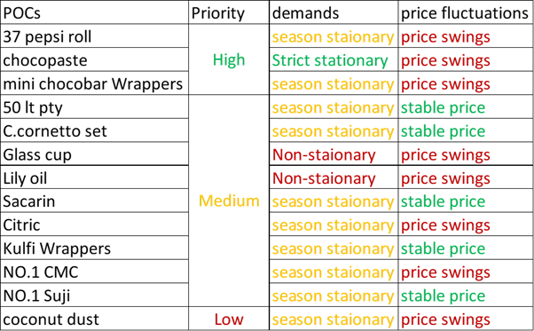
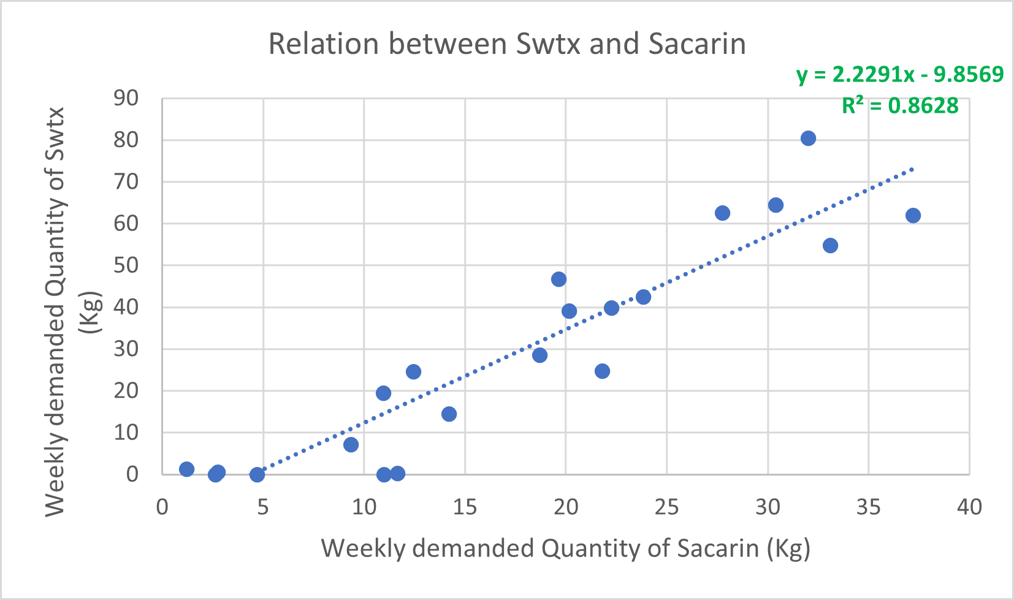
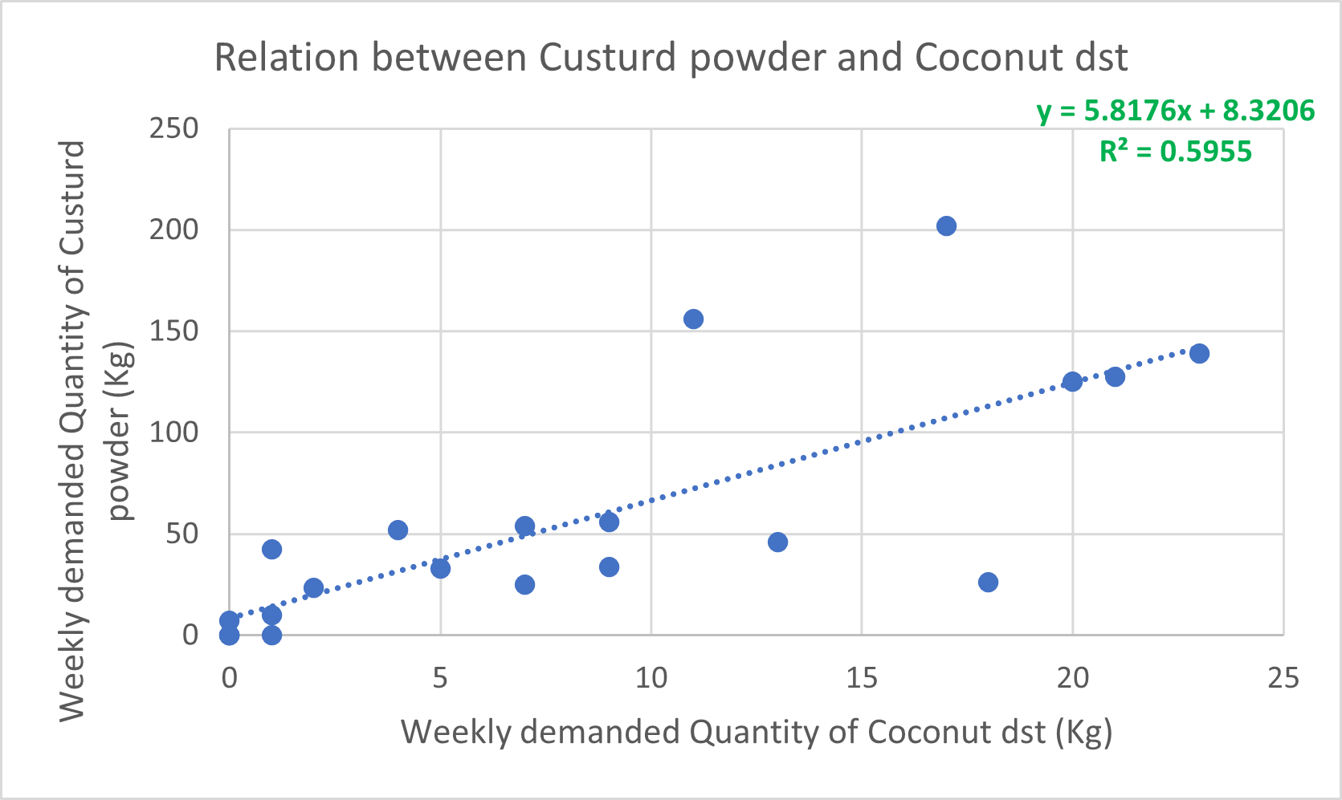

Categorization of POCs & some Additional Related POCs
POCs whose purchasing prices are fluctuating and/or which are categorized as medium to high priority and/or demand either stationary or season stationary are to be bulk stored during the off season.
13 products are identified as essential POCs.
Correlated POCs
An insightful observation came during the correlation analysis.
Some products have highly correlated demands $(r≥0.75)$.
3 highly correlated POCs are identified, in addition to 13 essential POCs.
Non essential POCs that are correlated to essential POCs, need to be bulked stored

Slide 8
Safety Stocks
Additional inventory held by a firm to mitigate the risk of supply shortage or price fluctuation.
Service availability of 99% gives a Z score of 2.33 from the standard normal distribution table.
the weekly safety stock = 2.33 × standard deviation(𝜎) of weekly demand.
Product category wise storage mechanism
Each 131 products can be categorized according to their nature, usage, and storage volume into different categories.
All the ice cream products can be categorized into seven broad categories. Some categories are food grade while the others are non food grade.
Products which are non food grade or has very low chances of contamination can be stored with varnish products.

Slide 9
Insights & Recommendations
DOs | Don’ts
Bulk stocking during the off season of winter months. Prioritizes storage and handling of the Products of Concern (POCs). Considering parameters like priority, price fluctuation, demand trends for bulk storage. Additional weekly safety stocks should be procured for smoother operations. diversifying the product category based on storage compatibility | Supply side pareto revealed, the firm spending a lot of resources on some products for which revenue is not high. No proper inventory management was observed. Separate storage of varnish and other products are not necessary.
Limitations
This project analyses the ice cream segment of the business and the data provided was only for this segment only.
Previous years historical data of would have given insights about the demand trends of products on YOY and MOM basis.

Slide 10


Thank You!
For Your Attention
22f1001555@ds.study.iitm.ac.in
www.linkedin.com/in/abhijitnandi007
Complete report : https://t.ly/XnBE1

